Slide 1

Recommender Systems

Slide 2


We are Over – Loaded !!
Thousands of news articles and blog posts each day.
Millions of movies, books and music tracks online.
Several thousands of ad messages and mails were sent throughout.
Loads of channels with even more programs.

Slide 3
Can google help me ???
Yes, But only when we really know what we are looking for …..
What if I just want some interesting music tracks ??
Btw, what does it mean by “interesting” ??

Slide 4





How does YouTube know what videos
we will watch ??
How does Google always seem to know
what news you’ll read?

Slide 5
They all use a Machine Learning technique called “Recommender Systems”
Want some Evidences ??
Netflix :
- 2/3 rented movies are from recommendation.
Google News:
- 38% more click through are due to recommendation.
Amazon :
- 35% sales are from recommendation

Slide 6


Rise of Recommender System :

Slide 7
What do Recommender System actually do :
Predict how much you may like a certain product.
Compose a list of N items for you.
Compose a list of N best users for a certain product.
Explain to you why these items are recommended .
Adjust the prediction and recommendation based on your feedback and other people.

Slide 8
Where Recommender System used :
Advertising messages
Investment choices
Restaurants
Cafes
Music Tracks
Movies
TV Programs
Books
Clothes
Supermarket goods
Tags
News articles
Online mates
Future friends
Courses e-learning
Drug components
Research papers
Citations
Code modules
Programmers

Slide 9
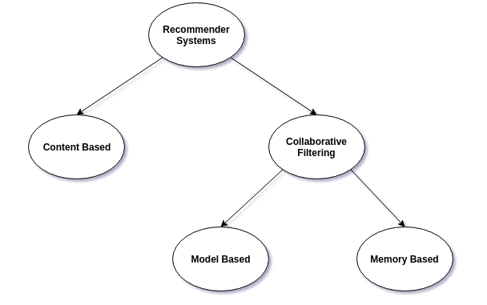
Different types of Recommender System :

Slide 10
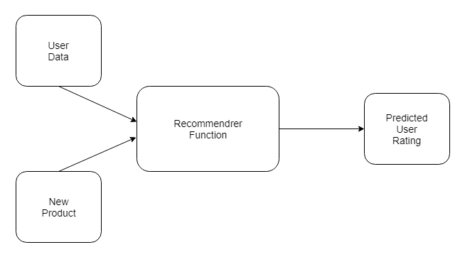
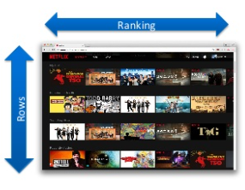
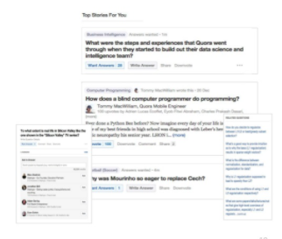
Everything is a “Recommendation” …!!!

Slide 11
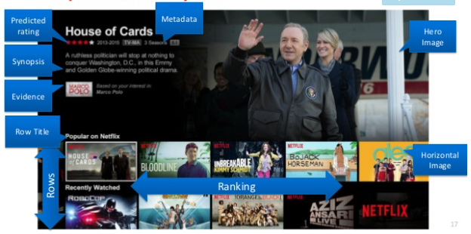

Slide 12
Collaborative filtering systems:
These are solely based on the past interactions between users and target items.
Input will be historical data of user interactions with target items.
Data stored in matrix where rows are users & columns are items.
Core idea behind such systems is that the historical data of the users should be enough to make a prediction. i.e we don’t need anything more than that historical data, no extra push from the user, no presently trending information etc.

Slide 13
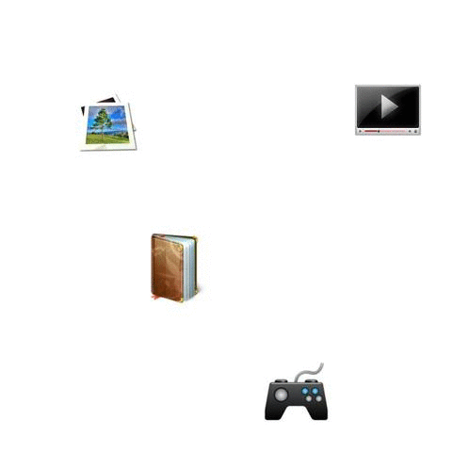
Working of Collaborative filtering:
Based on the users' historical data, the likes and dislikes of each item, the system tries to predict how the user would rate a new item that they haven’t rated yet. The predictions themselves are based on past ratings of other users, whose ratings and therefore supposed preferences, are similar to the active user. In this case, the system made the prediction / recommendation that the active user.

Slide 14

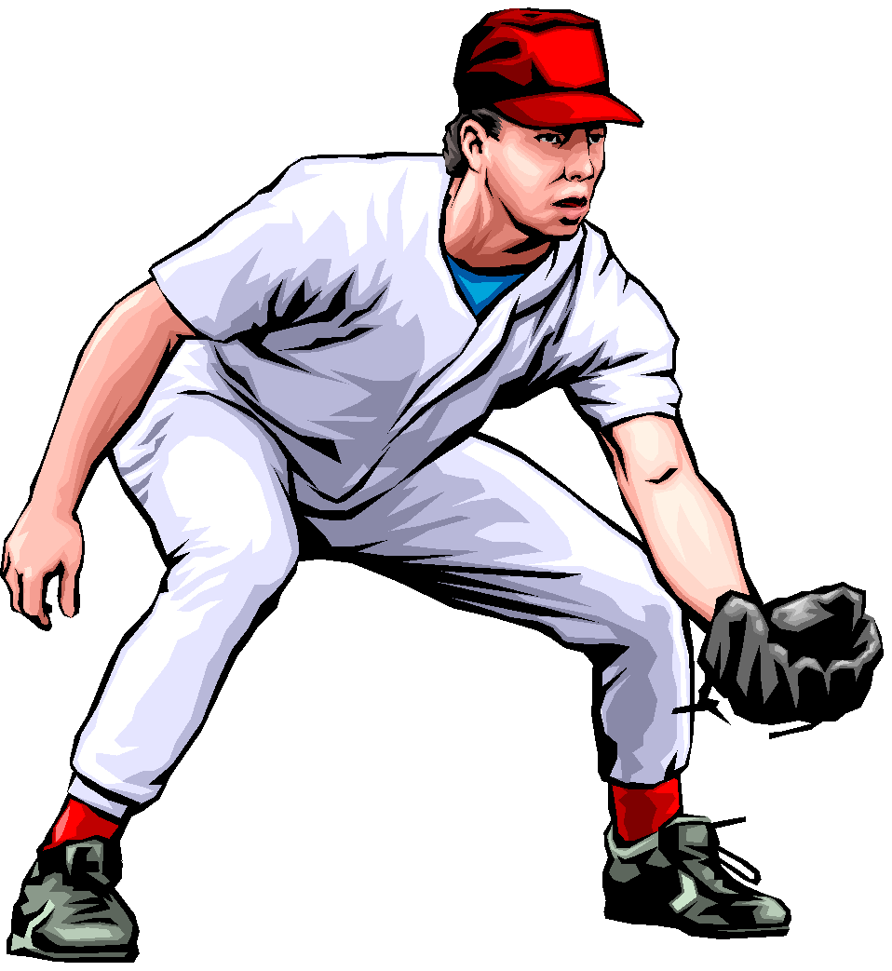

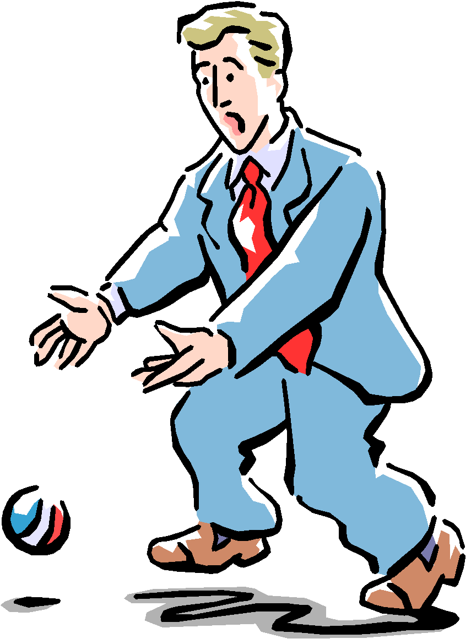

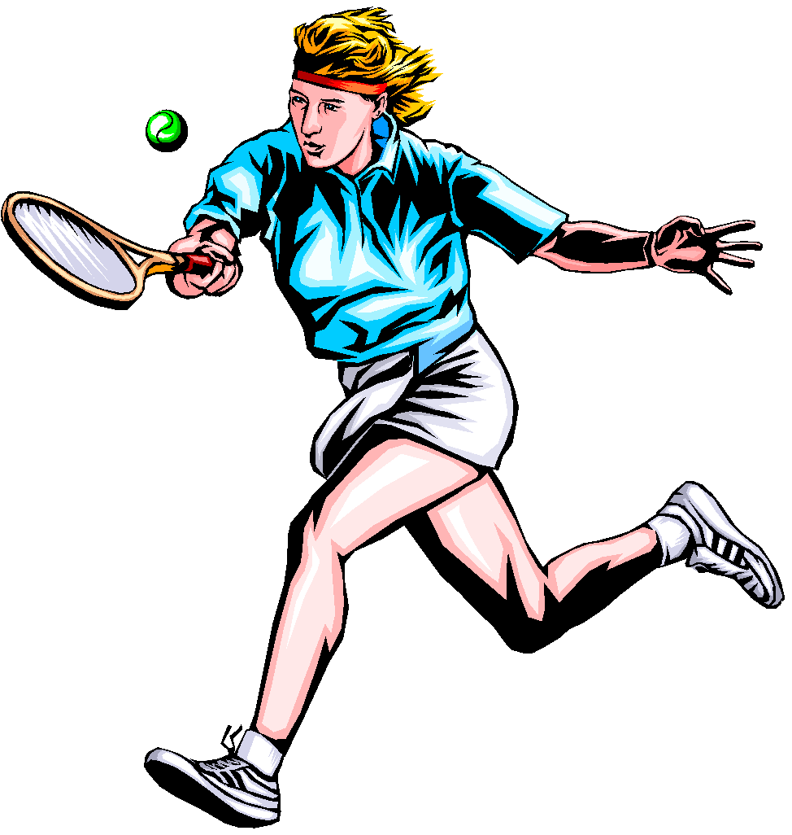

A 9
B 3
C
: :
Z 5
A
B
C 9
: :
Z 10
A 5
B 3
C
: :
Z 7
A
B
C 8
: :
Z
A 6
B 4
C
: :
Z
A 10
B 4
C 8
. .
Z 1
User
Database
A 9
B 3
C
: :
Z 5
A 10
B 4
C 8
. .
Z 1
Correlation
Match
A 9
B 3
C
. .
Z 5
Extract
Recommendations
Active
User
C

Slide 15
Collaborative Filtering are divided into 2 sub groups:
Memory Based method
Model Based method
Memory-based methods are the most simplistic as they use no model whatsoever. They assume that predictions can be made on pure “memory” of past data and usually just employ a simple distance-measurement approaches, like nearest neighbor.
Model based approaches on the other hand always assume some kind of underlying model and basically try to make sure that whatever predictions are coming outfit the model well.

Slide 16
We must take a good care of:
Data Normalization
Removal or reduction of noise
Protection of user’s privacy
Attack – Someone just doesn’t like your system
Collaborative Filtering can also be seen as:
User based method
Item based method
Matrix Factorization

Slide 17

User based Collaborative filtering:
Many people like Kungfu Panda
Can you tell how much I like it ???
The idea is to pick about 20 to 50 people who share similar taste with me, then how much I like depend on how much they like it.
In short : You may like it because your friends like it.

Slide 18
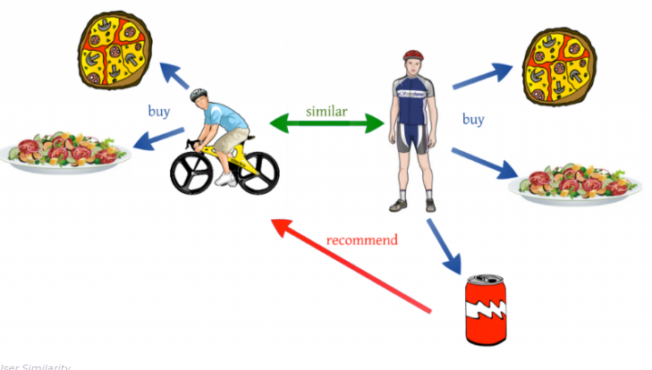
Simple Working of Collaborative filtering:

Slide 19

Item based Collaborative filtering:
I have watched so many good and bad movies.
Would you recommend me watching Taken ??
The idea is to pick from my previous list 20-50 movies that share similar audience with Taken, then how much like will depend on how much I like those early movies.
In short: I tend to watch this movie because I have watched those movies or people who watched those movies, also liked this movie.
(Amazon style)

Slide 20
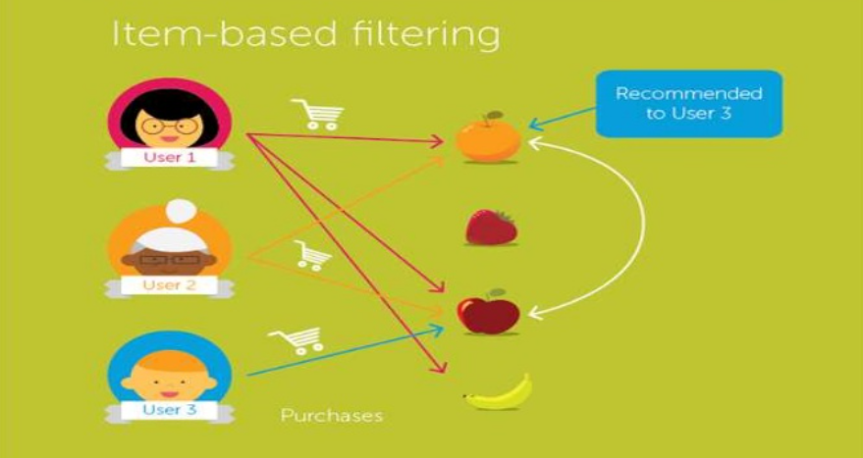

Slide 21
Collaborative filtering:
Various Tasks:
Inputs:
- Rating Data
- Event Data
- Explicit Feedback (Rating, Like/Dislike) vs Implicit feedback (Viewed item
page, time spent in page)
Goal:
- Rating Prediction
- Purchase Prediction
- Top n recommendations …..

Slide 22
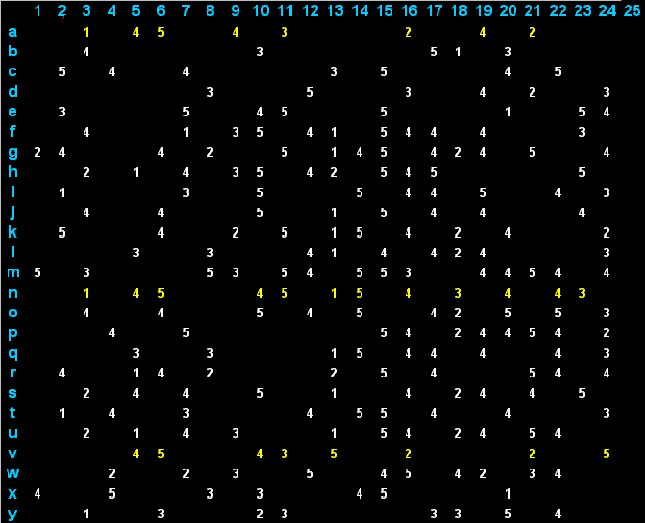
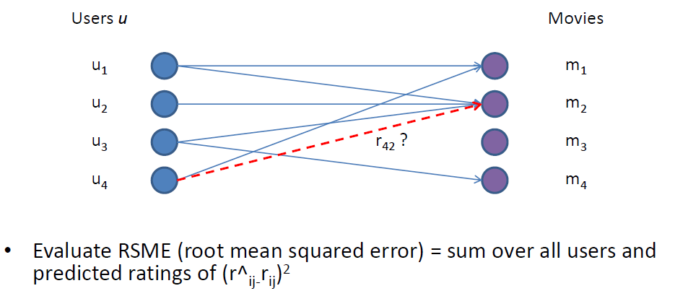
Collaborative filtering:
Rating prediction task:
Given a set of users U that have rated some set of items M, for each rating not yet present, predict the rating r_{ij} that user u_{i} will give item m_{j}
Ratings of users and items are represented
in a matrix.

Slide 23
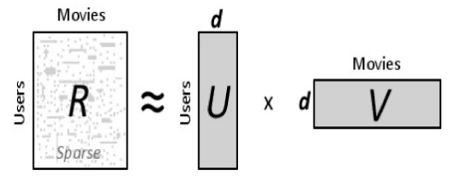
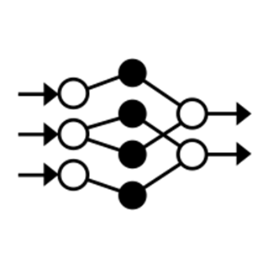
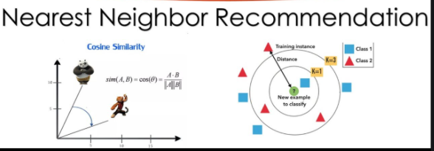
Collaborative filtering:
Popular techniques:
Nearest neighbour
Matrix Factorisation
Deep Learning

Slide 24
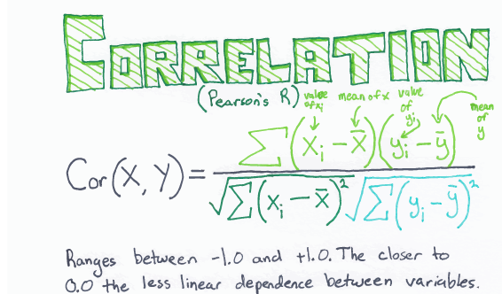
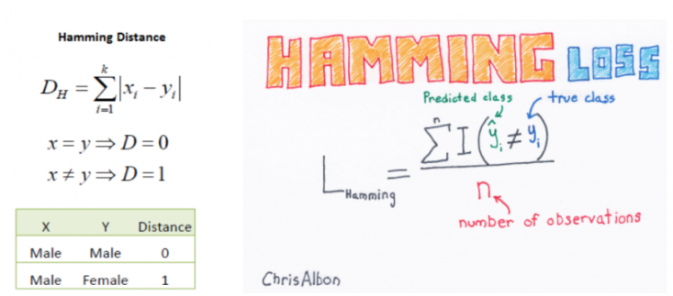
Collaborative filtering:
Nearest neighbour methods:
Using predefined similarity measures (such as Pearson or Hamming Distance)
Learning similarity the relations weights via optimization.

Slide 25
Using predefined similarity measure:
Current User
Users
1
1st item rate
0
Dislike
?
1
Like
0
abcd
abcd
Prediction
1
Unknown Rating
abcd
1
The prediction was made based on the nearest neighbor.
Other Users
This user did not rate the item. We will try to predict a rating according to his neighbors.
There are other users who rated the same item. We are interested in the Nearest Neighbors.
?
Unknown
1
0
Items
1
1
0
abcd
1
Nearest Neighbors
1
User Model = interaction history
We are looking for the Nearest Neighbor. The one with the lowest Hamming distance.
abcd
1
Nearest Neighbor
1
0
14th item rate
Hamming distance
5
6
6
5
4
8

Slide 26

Matrix factorization Collaborative filtering:
You may have watched thousands of
Movies perhaps belonging to 10 groups
namely action, sci-fi, animation, ……
So 10 numbers are enough to describe
your taste.
Likewise, Titanic has been watched by millions of people, but perhaps,
10 numbers are not enough to describe its features.
Magic: These hidden aspects can be discovered by this technique !!

Slide 27
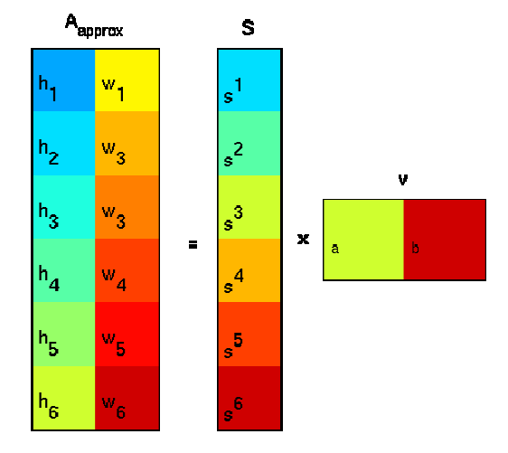
Matrix factorization Collaborative filtering:
In the Recommendation Systems field, Singular Value Decomposition (SVD) models users and items as vectors of latent features which when cross product produce the rating for the user of the item
With SVD a matrix is factored into a series of linear approximations that expose the underlying structure of the matrix.
The goal is to uncover latent features that explain observed ratings.

Slide 28

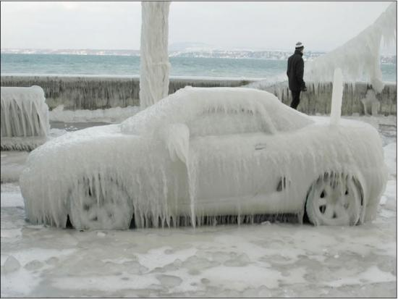
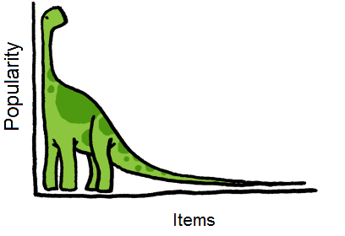
Problems with Collaborative filtering:
Scale
- Netflix(2007) : 5M users, 50K movies, 1.4B ratings
Sparse Data
- I have rated only one book on amazon
Cold – Start
- New users and items don’t have history
Popularity Bias
- Everyone reads “Harry Potter”
Long Tail
- Many items have only few ratings.

Slide 29
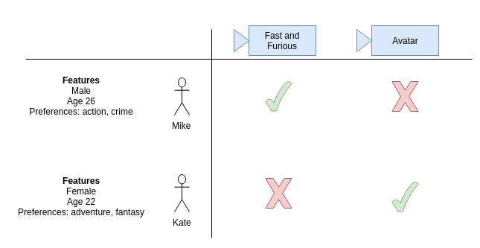
Working of content based filtering:
In contrast to collaborative filtering, these use additional information about
User/items to make predictions.
Our system input is the feature of the user and feature of the item. Our system output will be the prediction of whether or nor the user will like or dislike them.

Slide 30
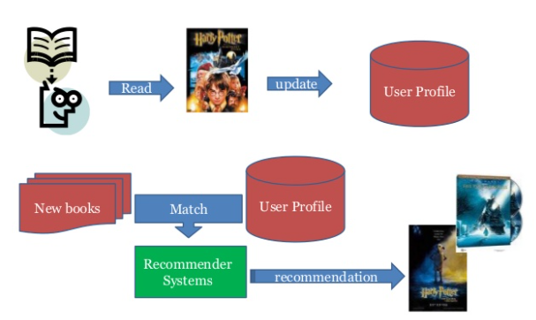
Measuring Similarity:
Cosine, TF – IDF as in standard information retrieval
KL Divergence for probability oriented
Euclidian Dimensionality

Slide 31
Advantages of content based filtering:
No need for data on other users.
- No cold-start or sparsity problems.
Able to recommend to users with unique tastes.
Able to recommend new and unpopular items
- No first-rater problem.
Can provide explanations of recommended items by listing content-features that caused an item to be recommended.

Slide 32
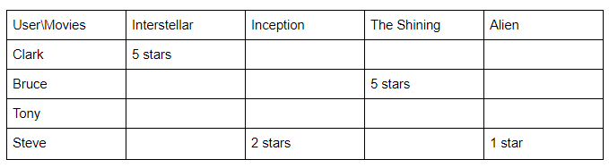
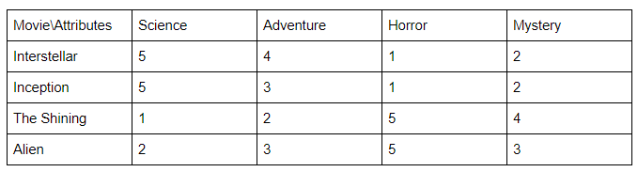
Content based filtering:
In this approach contents of the product are already rated and based on the user’s preference, then a rating is predicted for a similar product. .
Approach 1: using rated content to recommend
User Ratings
Movie attributes

Slide 33
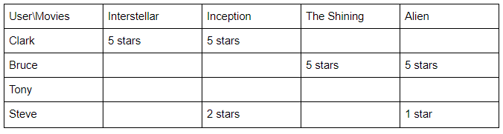
Predicted
User Ratings
Advantages:
- Works even a product has no reviews
Disadvantages:
- Requires descriptive data of all content to recommend, which is time consuming.
- It's also difficult to implement on large product databases as user’s have different opinions about each item.

Slide 34
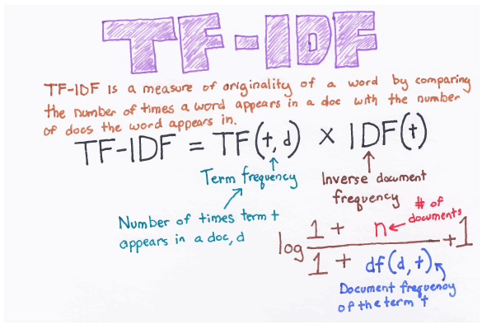
Approach 2: recommendation through description of content:
This approach uses the description of the item to make recommendations. The description goes deeper into the product details, like title, summary, tag lines, genre, etc., and it provides much more information about the item. Format of these details are in text format(string) and it's important to convert this into numbers to easily calculate for similarity.
TF-IDF is used in information retrieval for feature extraction purposes and it is a sub-area of natural language processing (NLP).

Slide 35
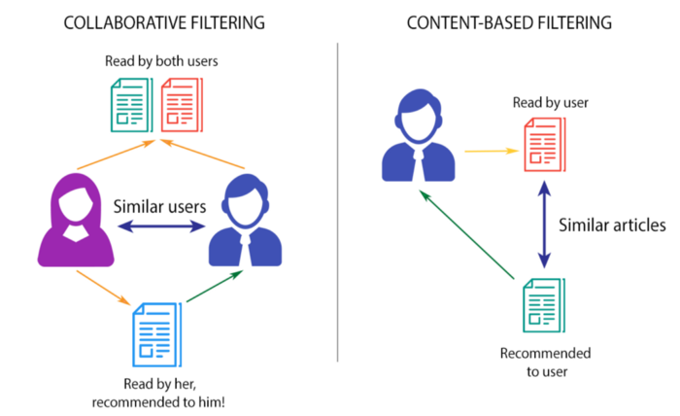

Slide 36
Knowledge Based Collaborative filtering:
In contrast to collaborative filtering, these use additional information about
User/items to make predictions.
Our system input is the feature of the user and feature of the item. Our system output will be the prediction of whether or nor the user will like or dislike them.

Slide 37
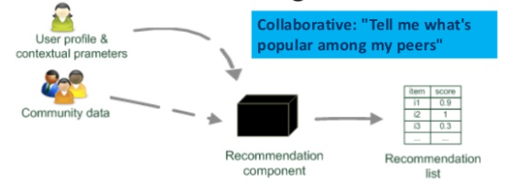
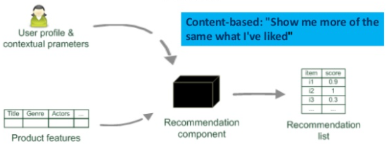

Slide 38
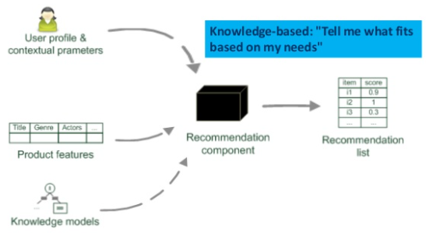
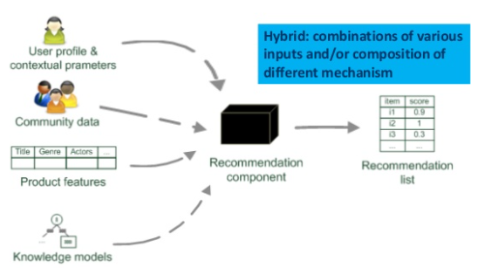

Slide 39
Cold start problem for recommender systems
The term derives from cars. When it’s really cold, the engine has problems with starting up, but once it reaches its optimal operating temperature, it will run smoothly. With recommendation engines, the “cold start” simply means that the circumstances are not yet optimal for the engine to provide the best possible results. In e-Commerce, there are two distinct categories of cold start: product cold start and user cold starts. Here we’re going to examine both.

Slide 40
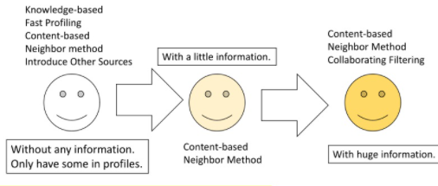
Difficulty : few amount of data

Slide 41
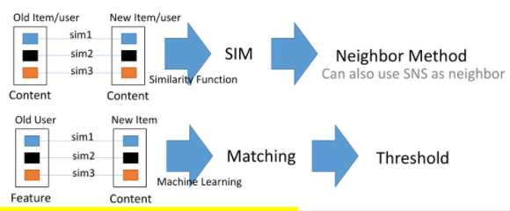
Cold start problem for recommender systems – solution:
Recommendations are based on the information on content of items rather than on other user’s opinion.

Slide 42
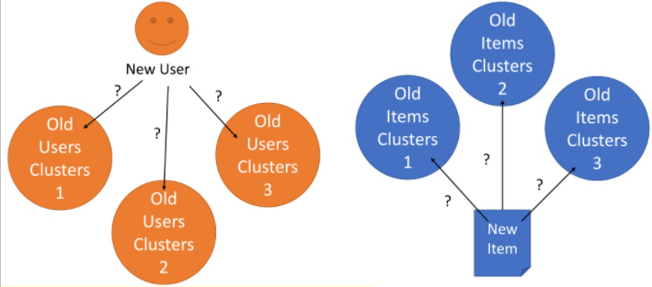
Cold start problem for recommender systems – other solution – neighbor by clustering:

Slide 43
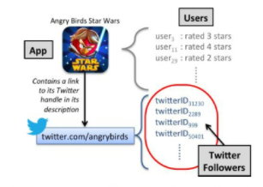
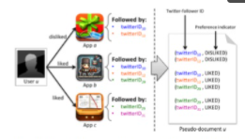
Cold start problem for recommender systems – other solution – borrow data from other platforms:

Slide 44
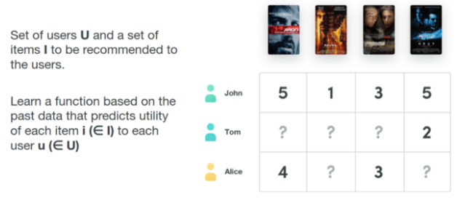
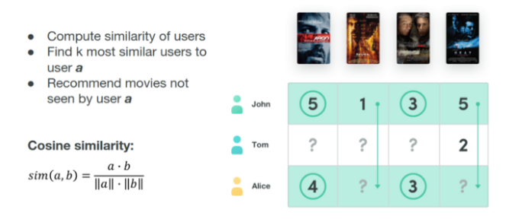
Approach to solve a recommender system problem:
User based K Nearest neighbours
Recommender Task

Slide 45
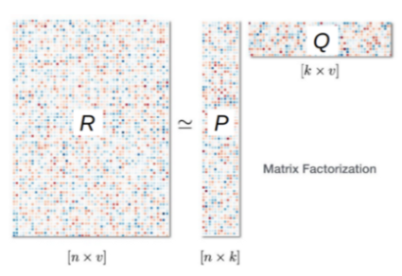
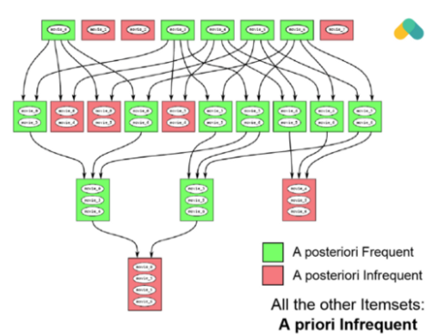
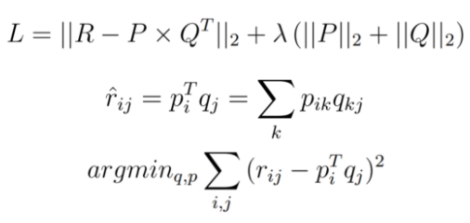
Algorithm computes cosine or correlation similarity of rows (users) or columns (items) and recommends items that k — nearest neighbors.
Matrix Factorisation
Apriori algorithm
or

Slide 46
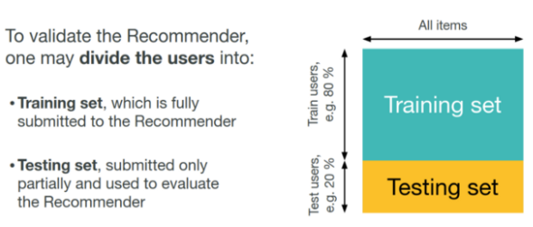
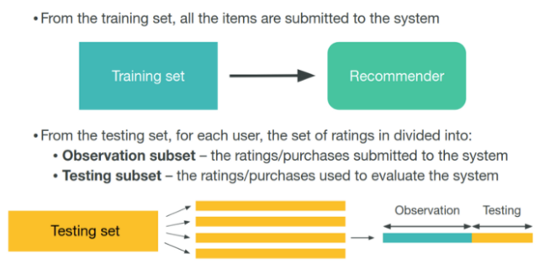
Evaluation of a recommender system problem:

Slide 47
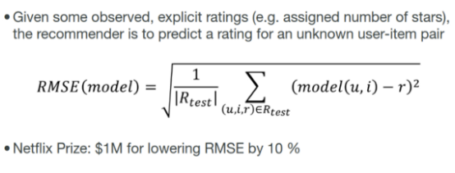
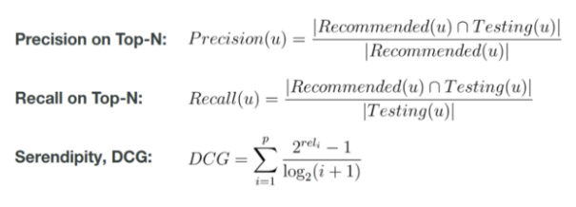
Evaluation measures – rating predictions:

Slide 48


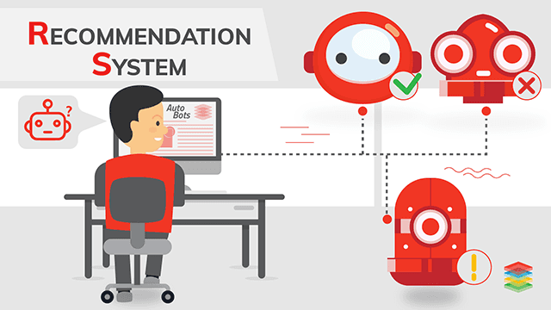

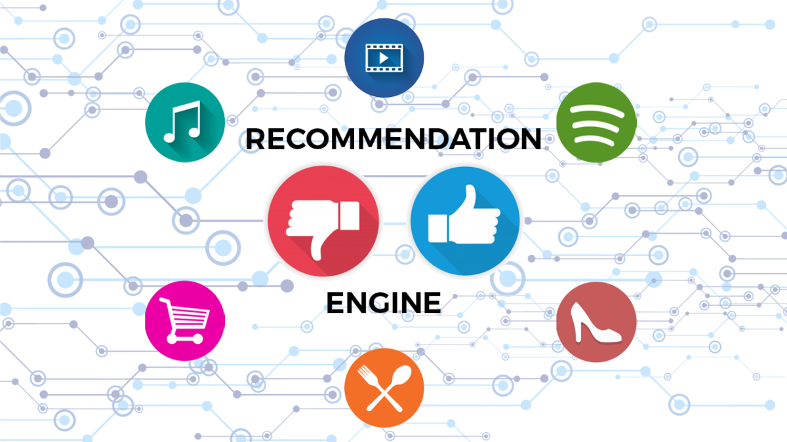
Expected project timeline:
Go thorough reading
& getting an idea about
the project – 10th Jun
Recommendation System
Implementation – 21st Jun
Play & get hands dirty with
Data – 14th Jun
Final Improvements – 24th June

